Slide 1

Day 1 (MM/DD/YYYY)
D-Code

Slide 2
Welcome!

Slide 3
Today’s Goals
Meet the Teachers & Procedures
Meet the Team
Discuss our goals
Discuss our workflow
Craft our team agreement
DEV TIME!

Slide 4
The Teachers

Slide 5
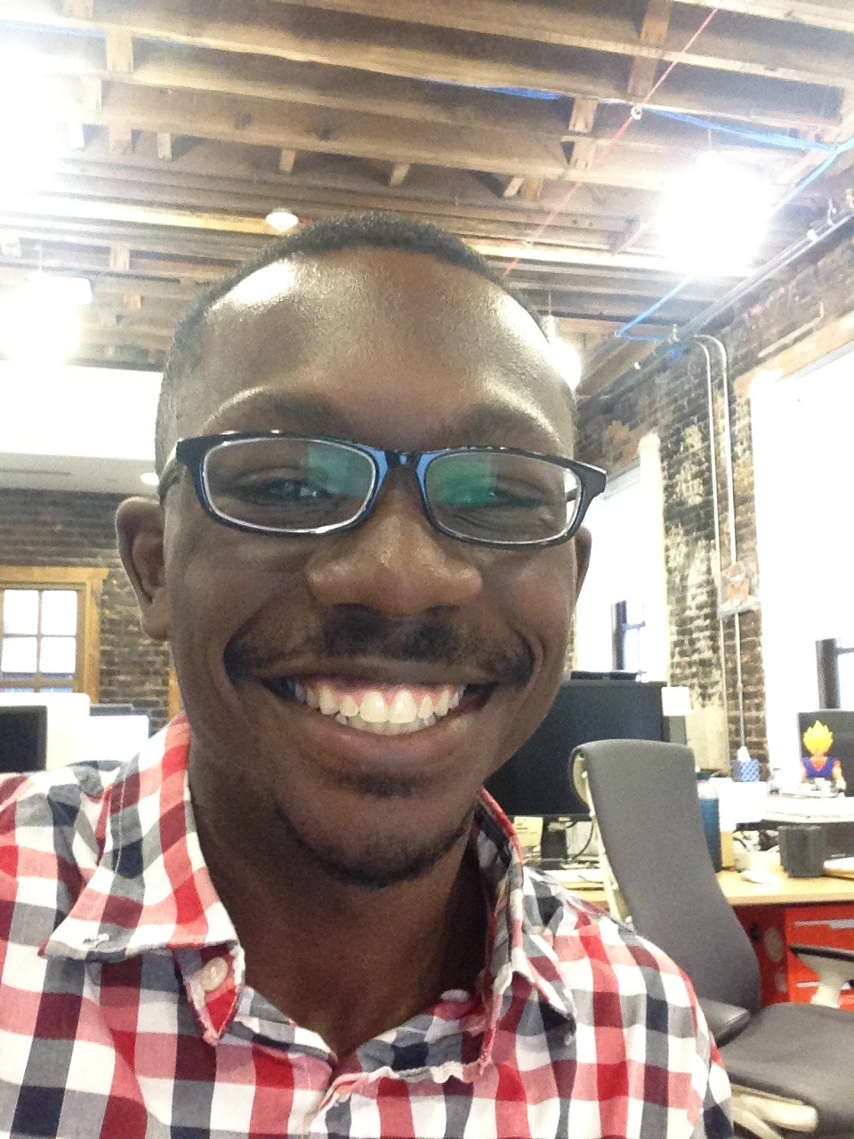
Kyle
Java/Android developer
Grew up in Ohio
Enjoy traveling and learning about different places
Graduated from Princeton
Like cereal, especially Honey Bunches of Oats
Into French hip-hop/pop at the moment

Slide 6
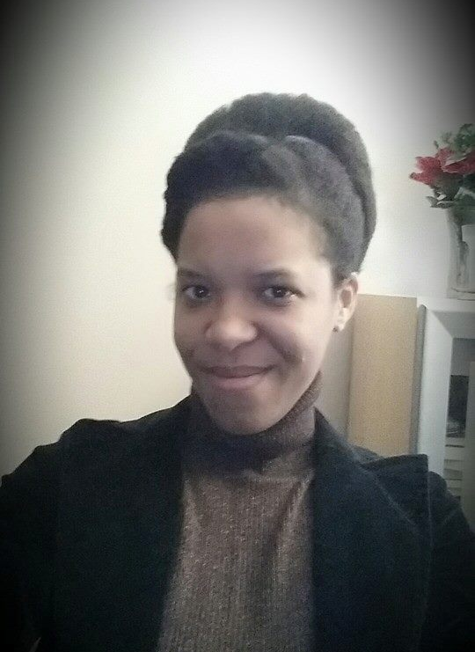
Brandy
Writer of Code (Java)
Writer of Words (Poetry)
Mom of two small humans
Detroit Born and Raised
Halo Mistress Chief (Ubisoft)
Reader of Sci-Fi
Part Android

Slide 7
The Procedures
(Why procedures? Isn’t school over?!)

Slide 8
The Procedures
Your reasons: _________
How have computers taken over the world?
Notes:
Ask students why they think we’re putting procedures in, especially when we’re not their classroom teachers.
Motivating story: how have computers taken over the world? Because they do what they do well. Take in the input, put out the output, not wasting time. Simple, but can do really complicated things that blow people’s minds—and they just get better and better. We want this class to be like that, so you can maximize your potential, not be mad at how the person next to you is cutting up.

Slide 9
The Procedures
Especially important because this is not a formal class.
Lot of freedom in programming in general…but also tons of ways to get lost, confused, frustrated.
We want that to happen as little as possible.

Slide 10
The Procedures
Get to class on time.
Be quiet at the start of class so we can start on time.
Notes:
Otherwise we lose precious time every day
Quiet ≠ silent, we can get your attention, but don’t be on 10

Slide 11
The Procedures
Listen when someone else is talking.
Notes:
Show respect you’d want
We don’t want to waste time, energy, goodwill repeating ourselves

Slide 12
The Procedures
Get silent when we need your attention to continue.
Notes:
Otherwise, takes forever to quiet down.
Is there some sort of signal you all use?
Hope you’re noticing a trend: there’s a reason for everything we’re doing, and it’s not to control your lives but to maximize your learning -> enjoyment.

Slide 13
The Procedures
Follow school rules.
Notes:
This isn’t school, but you’re in school and representing your school. Plus, why memorize two sets of rules?

Slide 14
The Procedures
Be respectful.
Notes:
Easy to define negatives--name-calling, putting people down, swearing/cussing people out—but (and this is not a rule) think of what an experience this would be if everyone felt relaxed, safe, happy with one another. Great, right? Let’s aim for that.

Slide 15
The Procedures
We’ll let you know if way you’re acting is disruptive or disrespectful—in class warning, after class conversation if needed.
If you keep choosing to act in such a way, you’ll have to leave (first time from class, second time from program).
Notes:
-Don’t expect that it will come to this.
-Not our job; here to teach you something new.
-Also, we’re understanding people—if having a rough day, you can talk to us, but can’t ruin things for others.

Slide 16
Questions?

Slide 17
Today’s Goals
Meet the Teachers & Procedures
Meet the Team
Discuss our goals
Discuss our workflow
Craft our team agreement
DEV TIME!

Slide 18
Meet the Team
There are two teams.
Everyone write a fact about themselves and put it in their team’s bag. Then, the teams switch bags.
The first person pulls out a fact and reads it aloud.
Then, they have two chances to guess who the fact belongs to.
If they get it right, their team gets a point. (If they get it wrong both times, don’t give it away yet!)
Continue until everyone has guessed.
Notes:
Directions for participants: The first student will read the fact aloud, guess who it belongs to. Limit 2 guesses. Then owner identifies themselves and restates their name and fact. Team (Everyone) gets a point for every right fact guess. Then, pass the bag on to the next student.

Slide 19
Today’s Goals
Meet the Teachers & Procedures
Meet the Team
Discuss our goals
Discuss our workflow
Craft our team agreement
DEV TIME!

Slide 20
Why are we here?

Slide 21
Team Goals
Introduce you to the world of software development
Learn the basics of Javascript, HTML and CSS
Use what we learn to ship something cool

Slide 22
Why are you here?

Slide 23
Individual Goals
A software developer’s most important development is themselves.
Remember that there is always something new to learn and we should be willing to learn something new every chance we get.
You will never know everything…
but you can always google it.

Slide 24
Goal Map
Notes:
In this program, it’ll be clear that only you can make yourself get the knowledge you want. That should be maybe a little scary, but also empowering!
Have students record 3 goals for this class.
Have students record 3 apprehensions they have about meeting their goals.

Slide 25
Today’s Goals
Meet the Teachers & Procedures
Meet the Team
Discuss our goals
Discuss our workflow
Craft our team agreement
DEV TIME!

Slide 26
How will this work?

Slide 27
Flow of Class
Review
Teaching & Exercise
Little bit of us talking or showing you a concept
Practice that concept on your own
Come back together, share and compare methods
Individual work time

Slide 28
Today’s Goals
Meet the Teachers & Procedures
Meet the Team
Discuss our goals
Discuss our workflow
Craft our team agreement
DEV TIME!

Slide 29
It’s like a contract… but collaborative
Notes:
Just want to go over bits and pieces of Brandy’s team’s working agreement at a high level (not get lost in all the detail):
Purpose is to show how we want to work as a team, from values to particular processes.
For our purposes, most important thing is values; we’ll learn the processes as we go on.

Slide 30
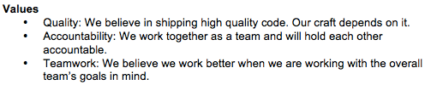
Sample Team Agreement

Slide 31
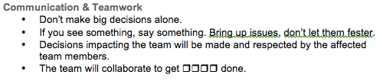
Sample Team Agreement
Notes:
An example of an important section. Others include “who should meetings involve”, “do we review each other’s code”, “how do we keep people in the loop about our availability”…

Slide 32
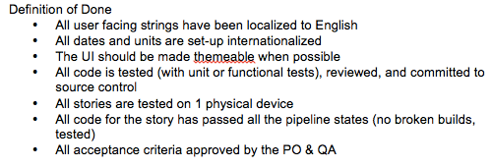
Sample Team Agreement

Slide 33
D-Code Team Agreement
Some things to keep in mind while we’re crafting our agreement:
Working Agreements are social contracts that outline how we will work as a team.
While every single team member is vital to the whole, we succeed or fail as a unit.
Give your opinions respectfully and receive other’s with equal respect.
Notes:
We will hold ourselves to standard we come up with.
Value we would like to include: Respect, Integrity and the Right Effort (not just acting for action’s sake)…
Time Commitment / Availability
We will be present each scheduled class.
We will be focused on our learning materials for that day.
If we know we will be absent we will let our team know.
Communication and Teamwork
We will communicate with respect to everyone.
We will give and receive constructive feedback.
We will get input from team members before making decisions that affect the team.
Effort
We will do our best to meet our deadlines.
If we cannot meet our deadlines, we will give our team members enough advance notice.
Coding and Code Review
We will write our best code.
We will follow Boy Scout Rules : “Leave it better than you found it”
We will be respectful and encouraging to teammates during code reviews, keeping in mind that we are all learning.
Personal Development
We will study on our own to further progress our knowledge (and bring it back to share!).

Slide 34
Today’s Goals
Meet the Teachers & Procedures
Meet the Team
Discuss our goals
Discuss our workflow
Craft our team agreement
DEV TIME!

Slide 35
break;
What is programming?
Notes:
Ask students to answer this question in their own words?

Slide 36


Slide 37
Anatomy of an EarSketch Project: What is programming?
Computer code is a collection of typed words that the computer can clearly understand. Just as a human translator might translate from the English language to Spanish, the computer interprets these words as ones and zeros. We as humans use programming languages, instead of writing directly in ones and zeros, so we can easily write and understand the computer code and can organize it.
Notes:
This is a definition we found online from a university in Georgia that we thought was pretty clear.

Slide 38
We can think of the different lines of our code as being individual instructions that we give to the computer. The computer follows these instructions explicitly to execute our written code.
http://earsketch.gatech.edu/category/learning/anatomy-of-an-earsketch-project/what-is-programming

Slide 39
continue;
We know that was a lot of information to take in but we promise that as we work together as a development team, utilizing these concepts to create viable products, and learning new and exciting concepts and tools, this first day will seem like the breeze.

Slide 40
Wait! Didn’t you say Dev Time?!

Slide 41
Developers Use Tools
Explore the Developer Tools - instructions (for Google Chrome)
Click “View”
Click “Developer”
Click “Developer Tools”
OR - Command + Option+ I

Slide 42
Udacity Challenge
Type the following in your browser:
http://udacity.github.io/js-basics/static-home/index.html
Open the Developer Tools, click on the tab that says “Console”
Type the following code exactly the way it is here, then press enter: $(".super-header-wrapper").html("<img style='width:100%' src='http://goo.gl/WCrBmS'>");
What happens?

Slide 43
finally{
talkAboutWhatWe’veLearned();
}
Notes:
Get answers from around the classroom:
1. Something that you learned today.
2. After today, how are you feeling?

Slide 44
Today’s Goals
Meet the Teachers & Procedures
Meet the Team
Discuss our goals
Discuss our workflow
Craft our team agreement
DEV TIME!
And now we’re done!
At least… by our definition of done.

